Slide 1
Project Update
Presented by:
Fateme Mazdarani
Mohammad Alshurbaji

Slide 2
Agenda
Preliminary Version
Quick Review
Preliminary Version
Our Contribution
Future Directions

Slide 3
Quick Recap
Reviewed a paper proposing quantum ML models to detect DGA-based botnet traffic
Hybrid Quantum DL
VQC
A comparison is crucial to assess the effectiveness and efficiency of VQC and hybrid models for cybersecurity applications.

Slide 4
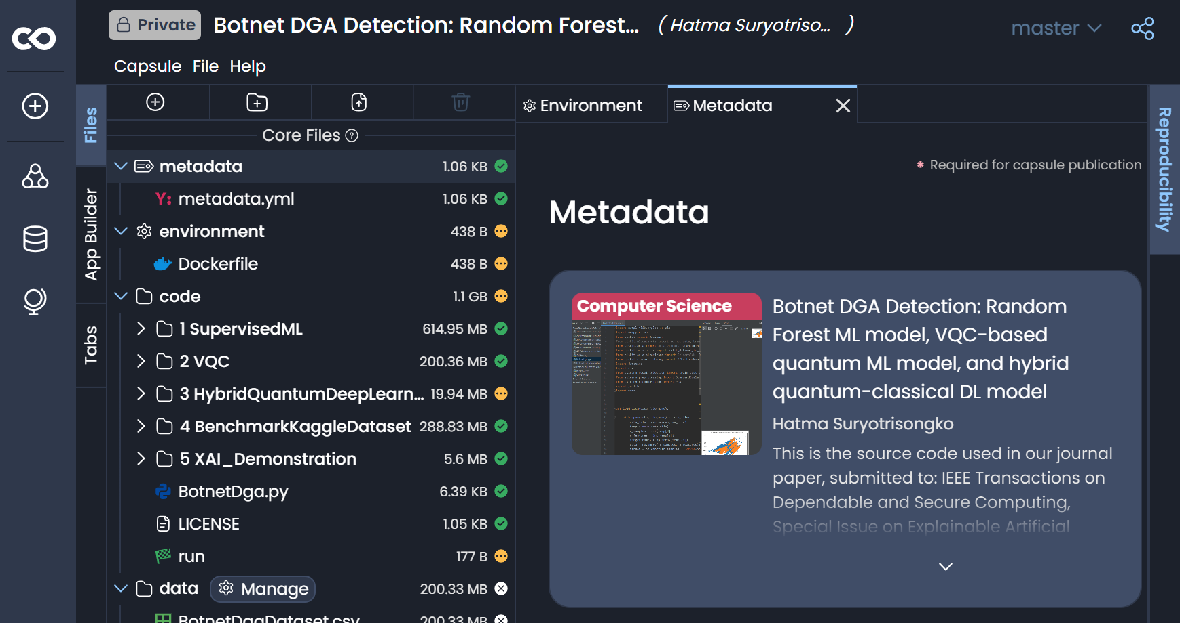
Preliminary Version
Challenges:
Deprecated Qiskit packages
TensorFlow compatibility issues

Slide 5
Our Contribution
Classical ML: benchmarked
VQC: Rebuilt from scratch
Hybrid Model: Still in progress

Slide 6
Classical Model Results

Slide 7
VQC
Outdated Code:
Built-In VQC removed from Qiskit 2.0 (Aqua Qiskit)
Outdated simulators
Optimizers were removed from Qiskit
Rebuilt from scratch

Slide 8
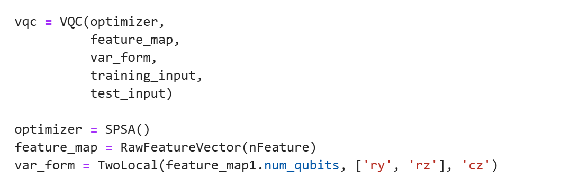
VQC

Slide 9
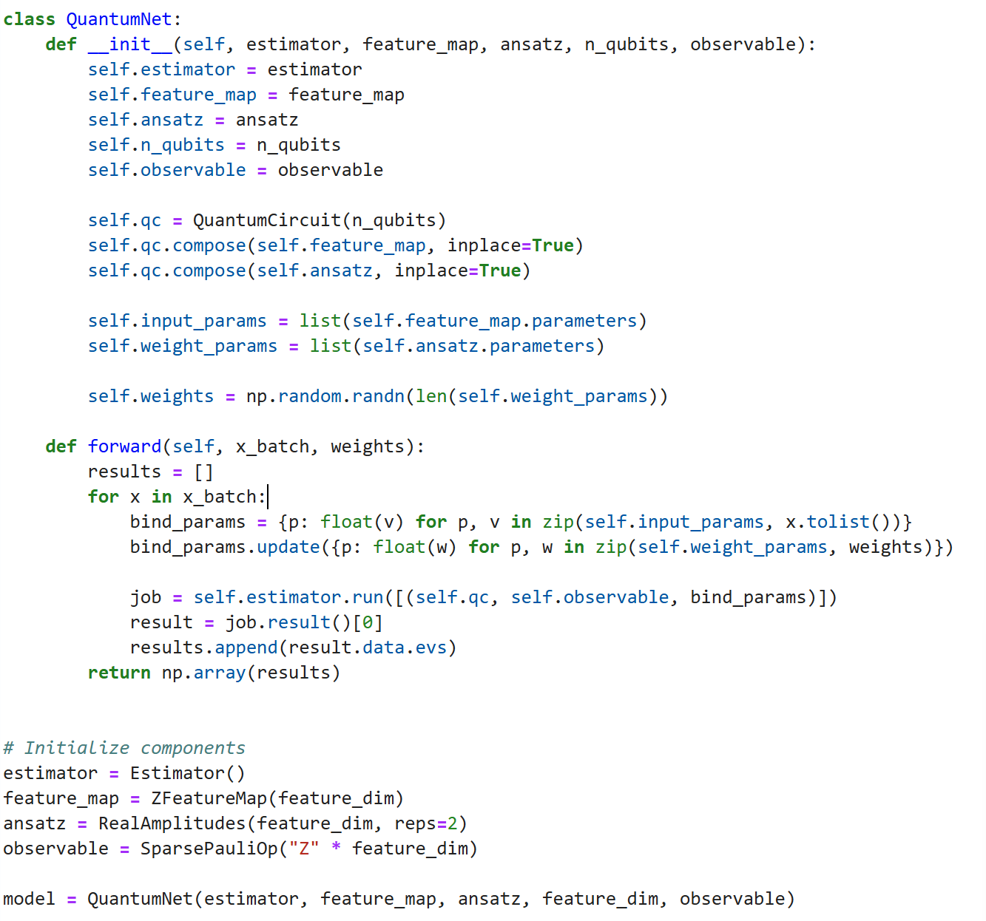
Updated VQC

Slide 10
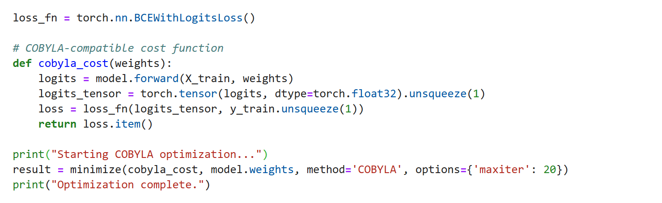
Implementing Optimizers:

Slide 11
VQC Results
RealAmplitudes Ansatz

Slide 12
Comparison between versions
RealAmplitudes+COBYLA

Slide 13
HYBRID Quantum Deep learning MODEL

Slide 14
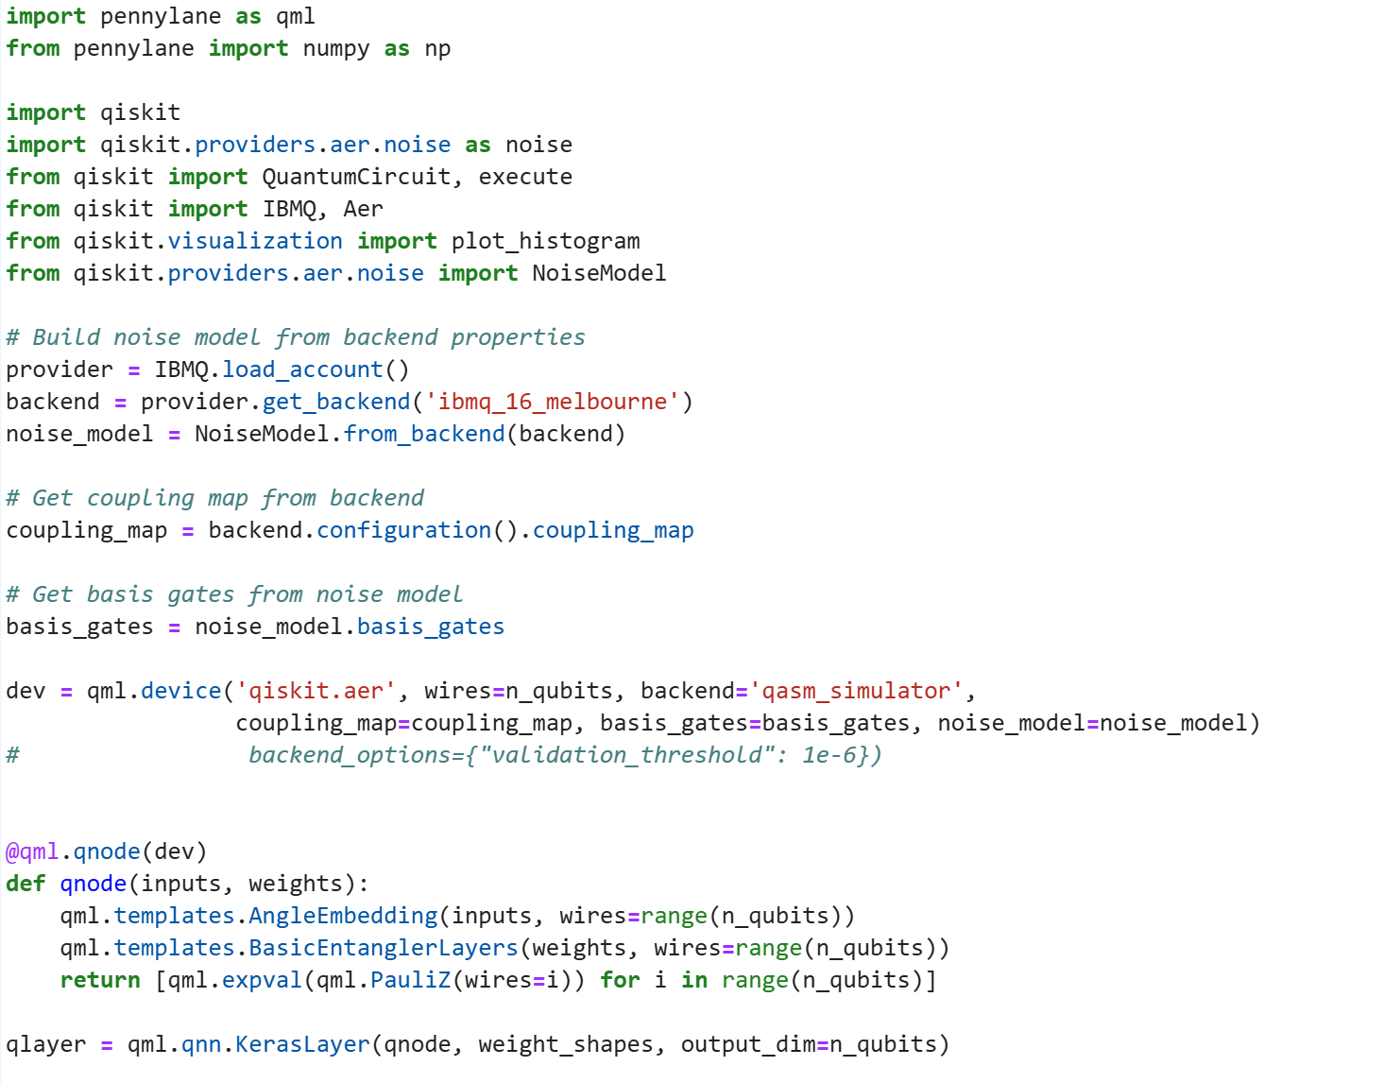












ERRORS!

Slide 15
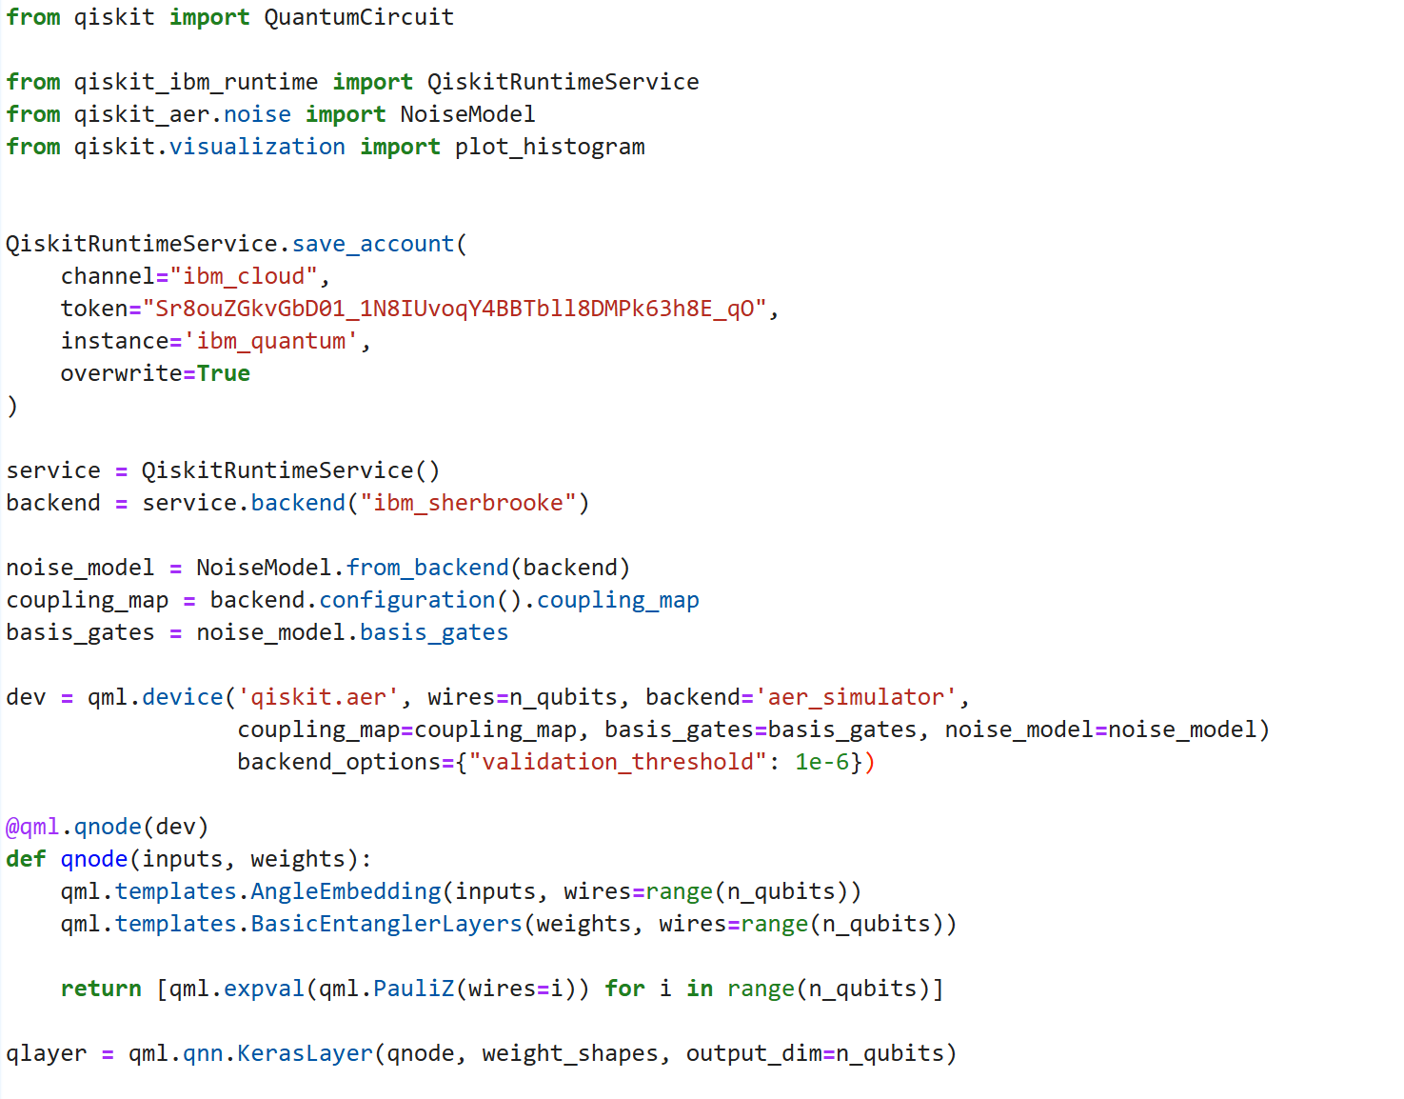







REVISED THE CODE
STILL ERRORS!

Slide 16
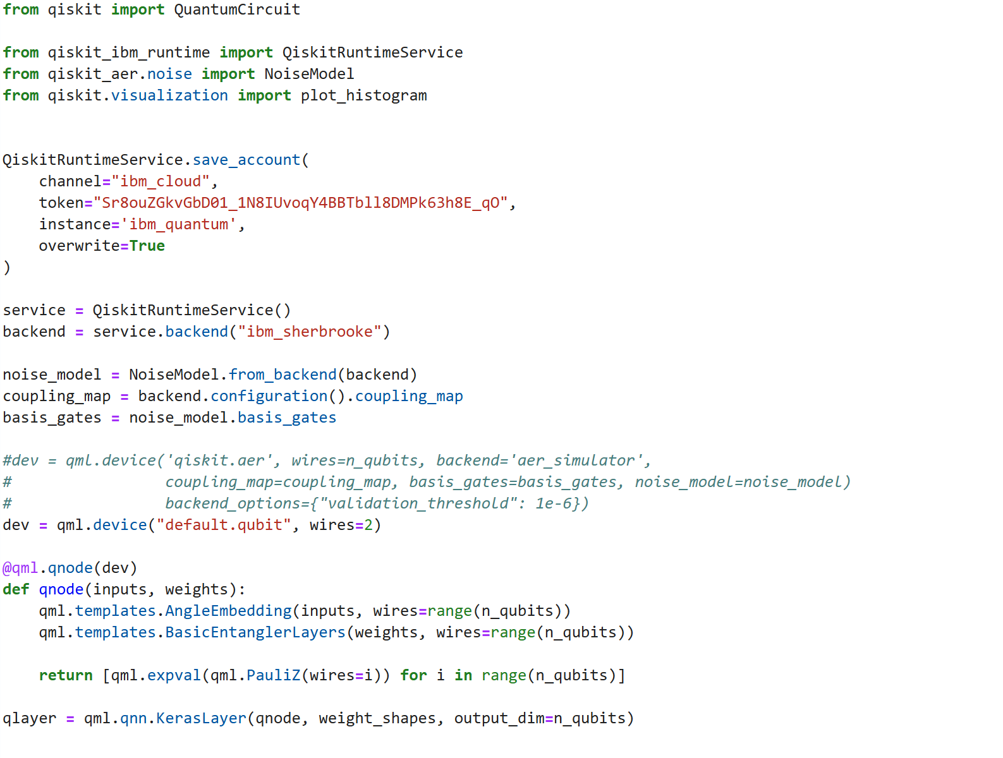

AND STILL ERRORS!

Slide 17
What’s Next?
VQC:
Adding More Optimizers to expand the benchmark
Improve the results
Quantum-DL:
Revising the code and go errorless!
Do the comparison

Slide 18
Questions?

Slide 19
THANK YOU

